Slide 1

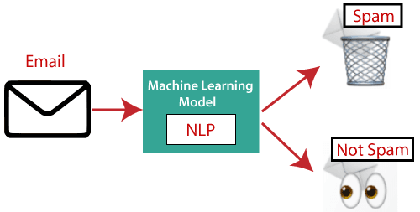

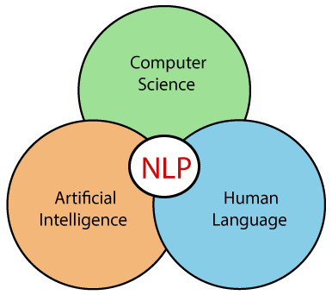
Natural Language Processing
- Speech Recognition
Sentiment Analysis
- Natural Language Understanding (NLU)
Question Answering
(Alexa/Siri)
Spam Detection
Information extraction

Slide 2
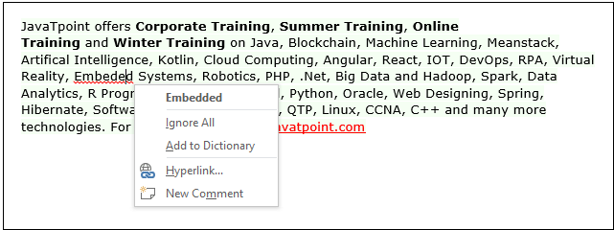
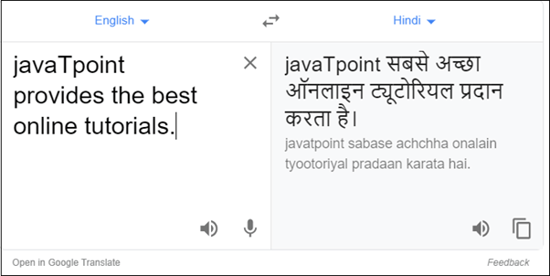
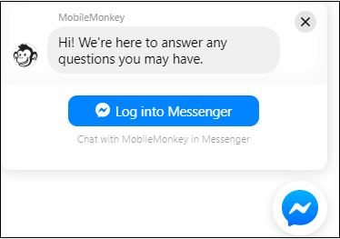
Natural Language Processing
Spelling Correction
Machine Translation
chatbot

Slide 3
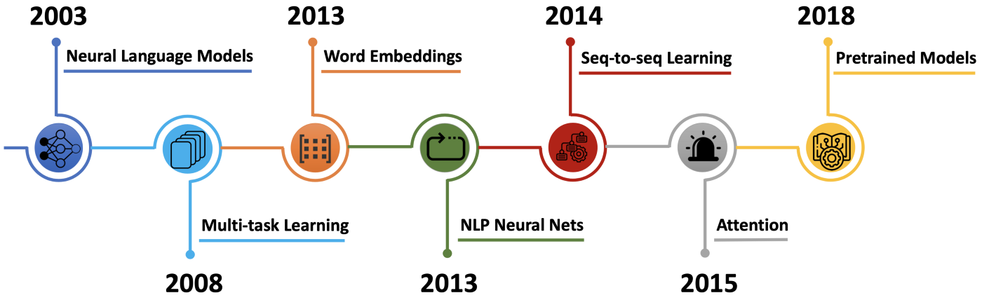
Overview in NLP
2001 - Neural language models
2008 - Multi-task learning
2013 - Word embeddings
2013 - Neural networks for NLP
2014 - Sequence-to-sequence models
2015 - Attention
2015 - Memory-based networks
2018 - Pretrained language models

Slide 4
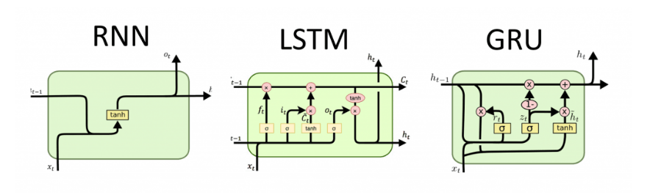
Traditional Language Models

Slide 5
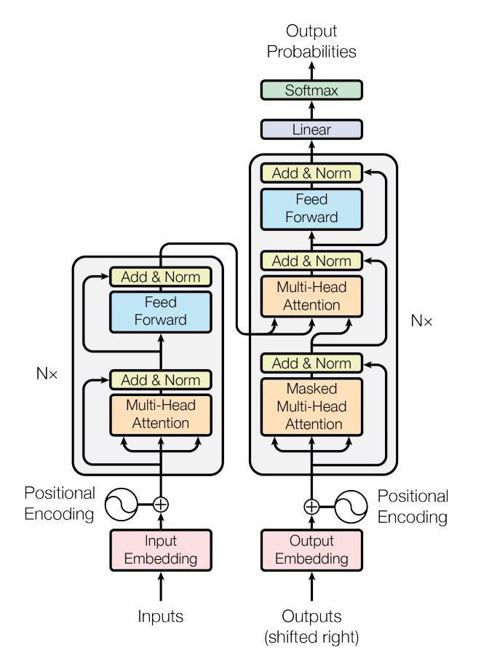

Language Model - Transformer

Slide 6
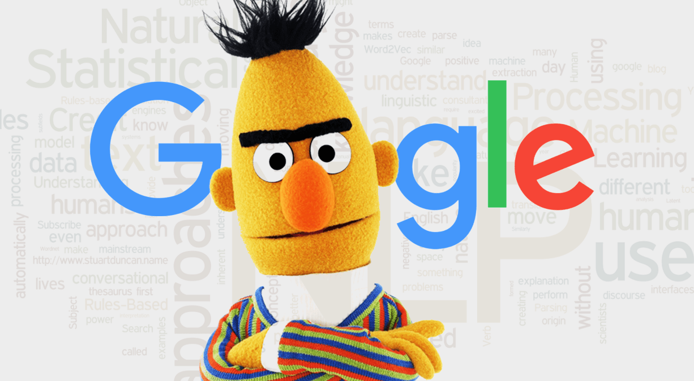
BERT
Bidirectional Encoder Representations from Transformers (BERT) is a transformer-based machine learning technique for natural language processing (NLP) pre-training developed by Google.

Slide 7
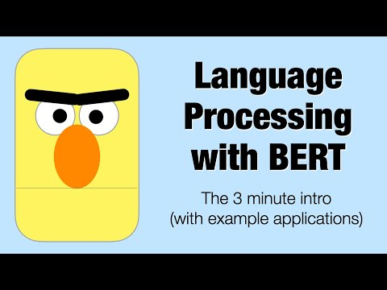
BERT
Bidirectional Encoder Representations from Transformers (BERT) is a transformer-based machine learning technique for natural language processing (NLP) pre-training developed by Google.

Slide 8
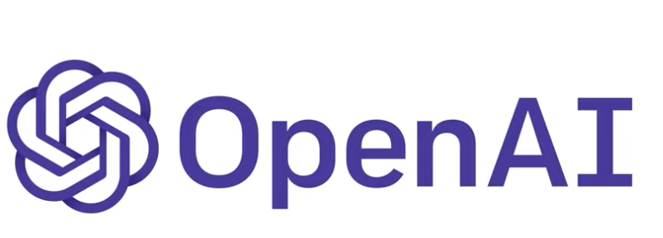
Language Model – GPT3
Generative Pre-trained Transformer 3 (GPT-3) is a language model that leverages deep learning to generate human-like text (output). Not only can it produce text, but it can also generate code, stories, poems, etc.
It is created by OpenAI, an artificial resource laboratory in San Francisco. The 175 billion parameter deep learning model was trained on large text data set with hundreds or billions of words.
https://www.youtube.com/watch?v=Zm9B-DvwOgw&list=PLOXw6I10VTv_FhQbbvYh1FvbiaPf43Ve2&index=3

Slide 9
